Slide 1
Coherent Online Video Style Transfer
Dongdong Chen , Jing Liao , Lu Yuan , Nenghai Yu , and Gang Hua
University of Science and Technology of China,
Microsoft Research Asia
(ICCV 2017)
朴智新
2018年6月29日

Slide 2
What is Video Style Transfer?

Slide 3
What is Style Transfer?

Slide 4
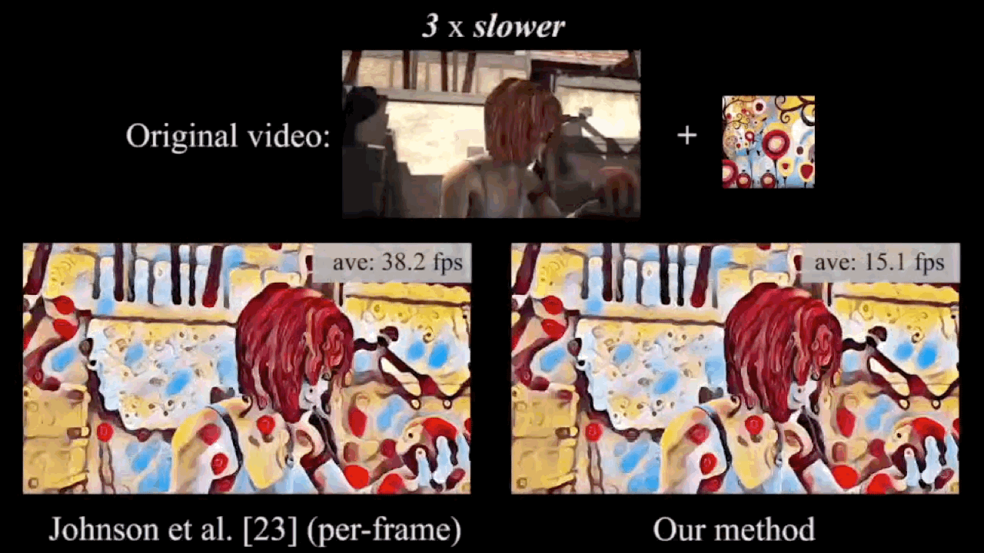
What is Video Style Transfer?

Slide 5
Why is it challenging and/or haven't been solved?

Slide 6
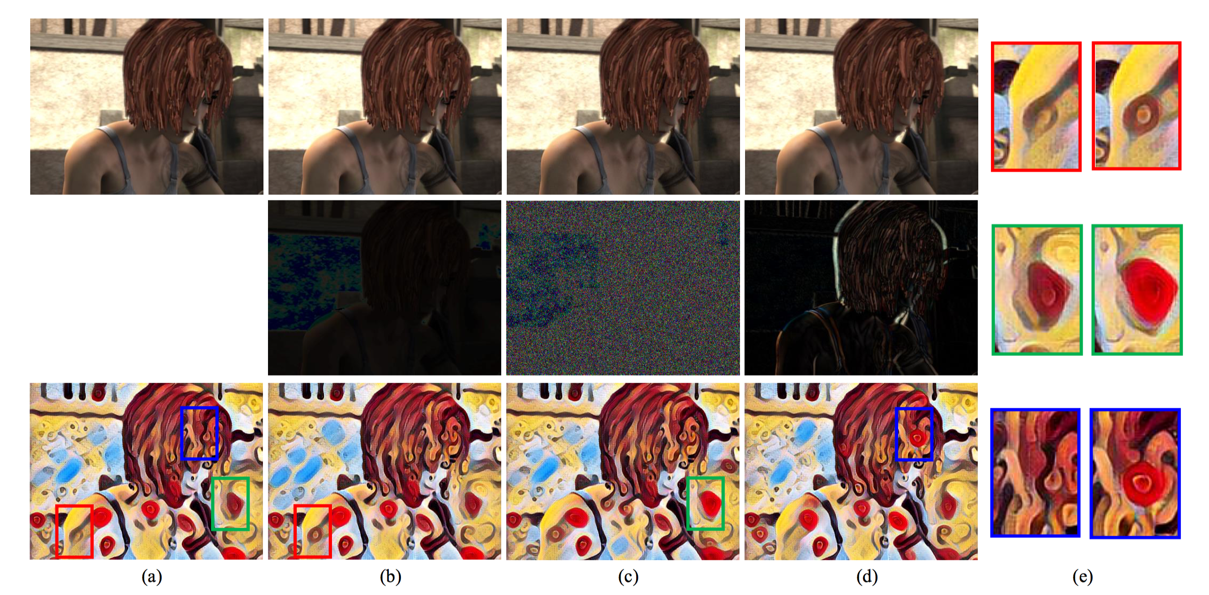
Why is it challenging and/or haven't been solved?
the original one,
5% lighter than (a),
Gaussian noises (µ = 0, σ = 1e − 4) added to (a)
the next frame of (a) with subtle motions.

Slide 7
Main idea and Methodology

Slide 8
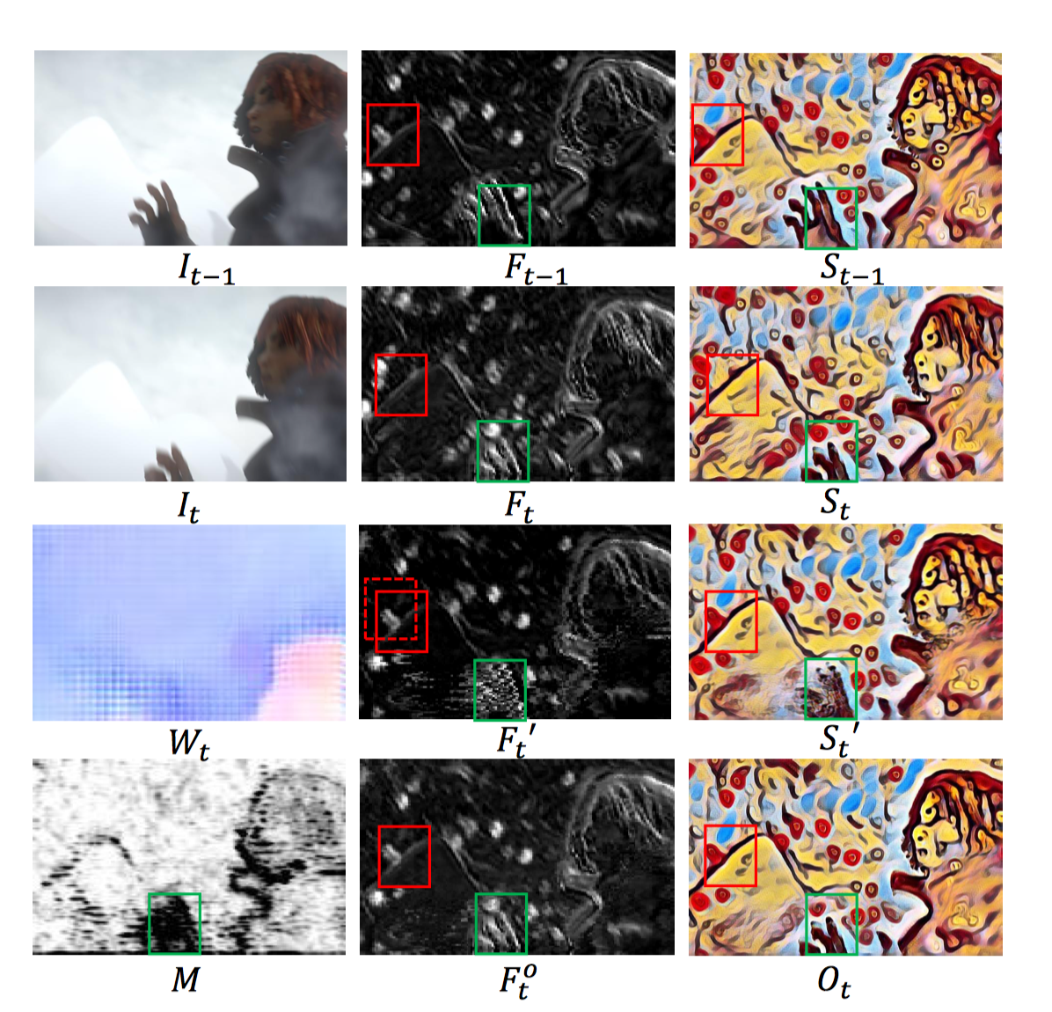
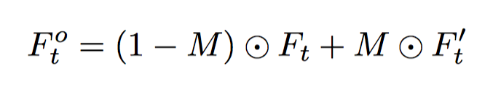
Motivation
Red: texture patterns
Green: ghosting
Use optical-flow warp feature F_{t-1} to F’_{t}
Is there a mask M to trade off between F_{t-1} and F’_{t}?

Slide 9
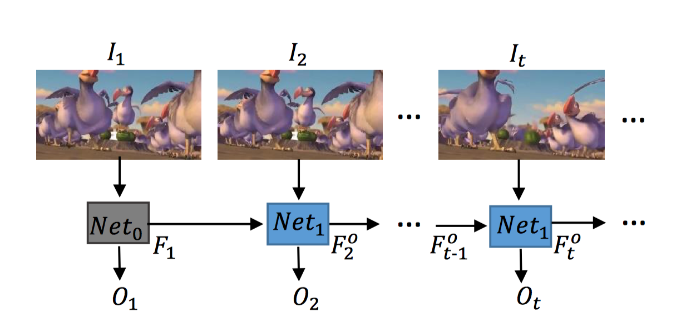
System Overview
Use history information to stabilize stylized result
Notes:
http://cocodataset.org/#keypoints-leaderboard

Slide 10
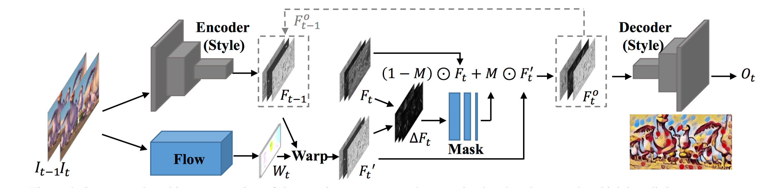
Architecture Overview
This network architecture consists of three main components: the pretrained style sub-network, which is split into two parts: an encoder and a decoder; the ﬂow sub-network to predict intermediate feature ﬂow; and the mask sub-network to regress the composition mask.
Notes:
http://cocodataset.org/#keypoints-leaderboard

Slide 11
Architecture Overview
pretrained style sub-network
adopt the pre-trained image style transfer network of Johnson et al. as our default style sub-network.
since it is often adopted as the basic network structure for many work.
Notes:
http://cocodataset.org/#keypoints-leaderboard

Slide 12
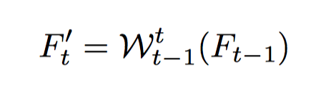
Architecture Overview
flow sub-network
FlowNet
where $W_{t−1}^{t}$(·) denotes the function that warps features from t − 1 to t using the estimated ﬂow ﬁeld W_{t}
Notes:
http://cocodataset.org/#keypoints-leaderboard

Slide 13
Architecture Overview
mask sub-network
We mask out two types of pixels, being set to 0 in M ground-truth :
1) the occlusion pixels achieved by crosschecking the forward and backward ﬂows;
2) the pixels at motion boundaries with large gradients of ﬂow, which are often less accurate and may result in ghosting artifacts in composition.
All other pixels are set to 1.
Notes:
http://cocodataset.org/#keypoints-leaderboard

Slide 14
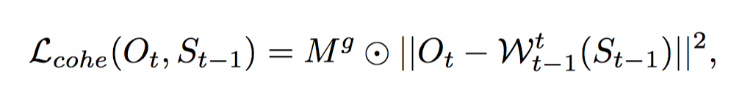
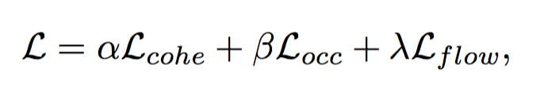
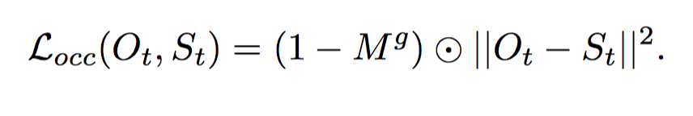
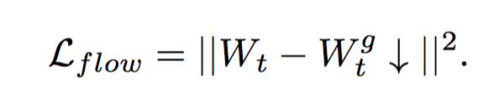
Architecture Overview
where S_{t} is the stylized result produced independently at t
Notes:
http://cocodataset.org/#keypoints-leaderboard

Slide 15
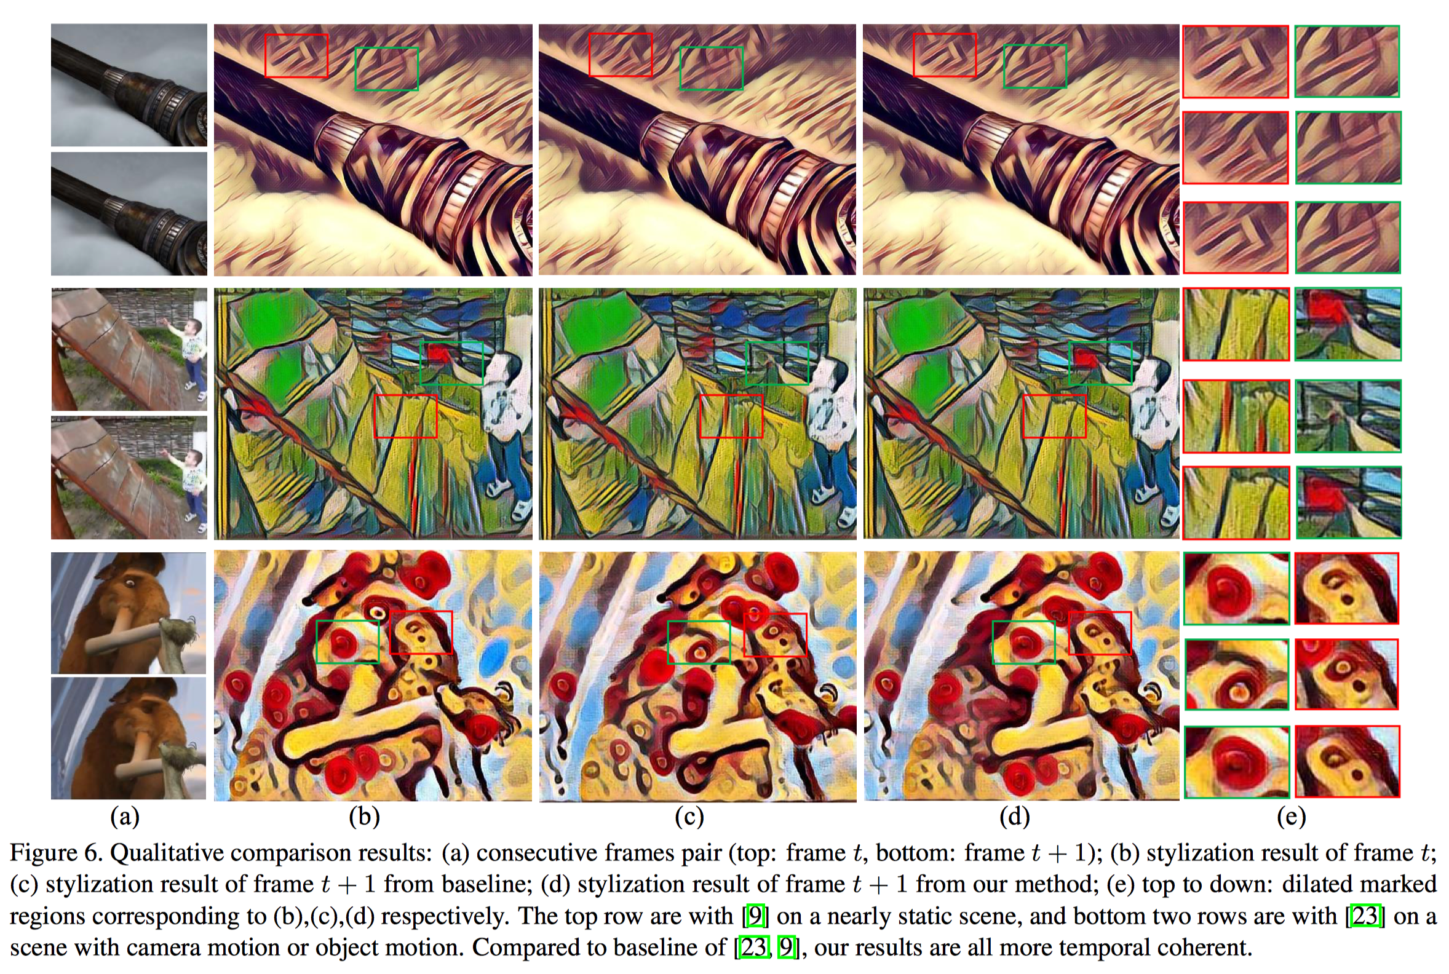
Result
Notes:
http://cocodataset.org/#keypoints-leaderboard

Slide 16
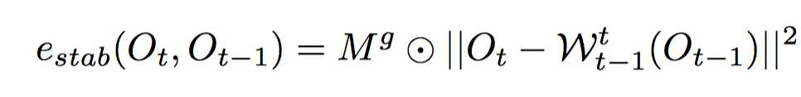
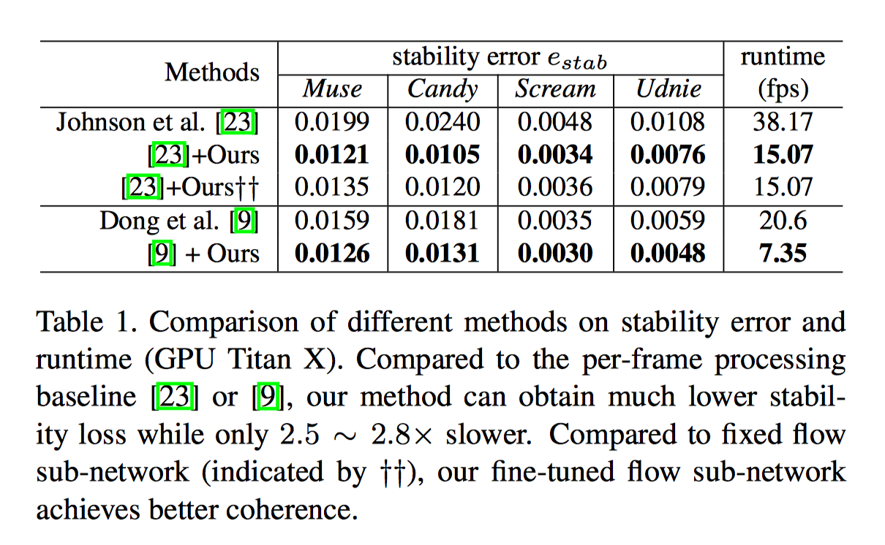
Measure
Notes:
http://cocodataset.org/#keypoints-leaderboard

Slide 17
Summary
Our network is the ﬁrst network leveraging temporal information that is trained end-to-end for video style transfer, which successfully generates stable results.
Our feed-forward network is about thousands of times faster compared to optimization-based style transfer in videos, reaching 15 fps on modern GPUs.
Our method enables online processing, and is cheap in both learning and inference, since we achieve the good approximation of long-term temporal coherence by propagating short-term one.
Our network is general, and successfully applied to several existing image stylization networks, including per-style-per-network or mutiple-style-pernetwork.

